Slide 1
PowerApps Canvas App
IAF Form
By Kartikey Doshi

Slide 2
Project Goal
Create an app in PowerApps which does the following:
Receive and Submit Forms with multiple types of fields by the User
Create an approval process with 2 Approvers
Populate a change history of the form using Power Automate
Allow editing and resubmission of the forms (after rejection) by the User
Allow Approvers to Add Comments to the form
Allow filtering requests by approval status
Allow viewing of requests(forms) by the approvers and the users
Allow new request submissions and tracking existing requests by the User.

Slide 3
Technical Specifications
The App works with:
1 Admin and 2 Approvers on the Organisation Level
1 SharePoint Site with 5 SharePoint Lists
Microsoft Environment,to share it with other members
5 Power Automate Flows
MS PowerApps License for all users

Slide 4
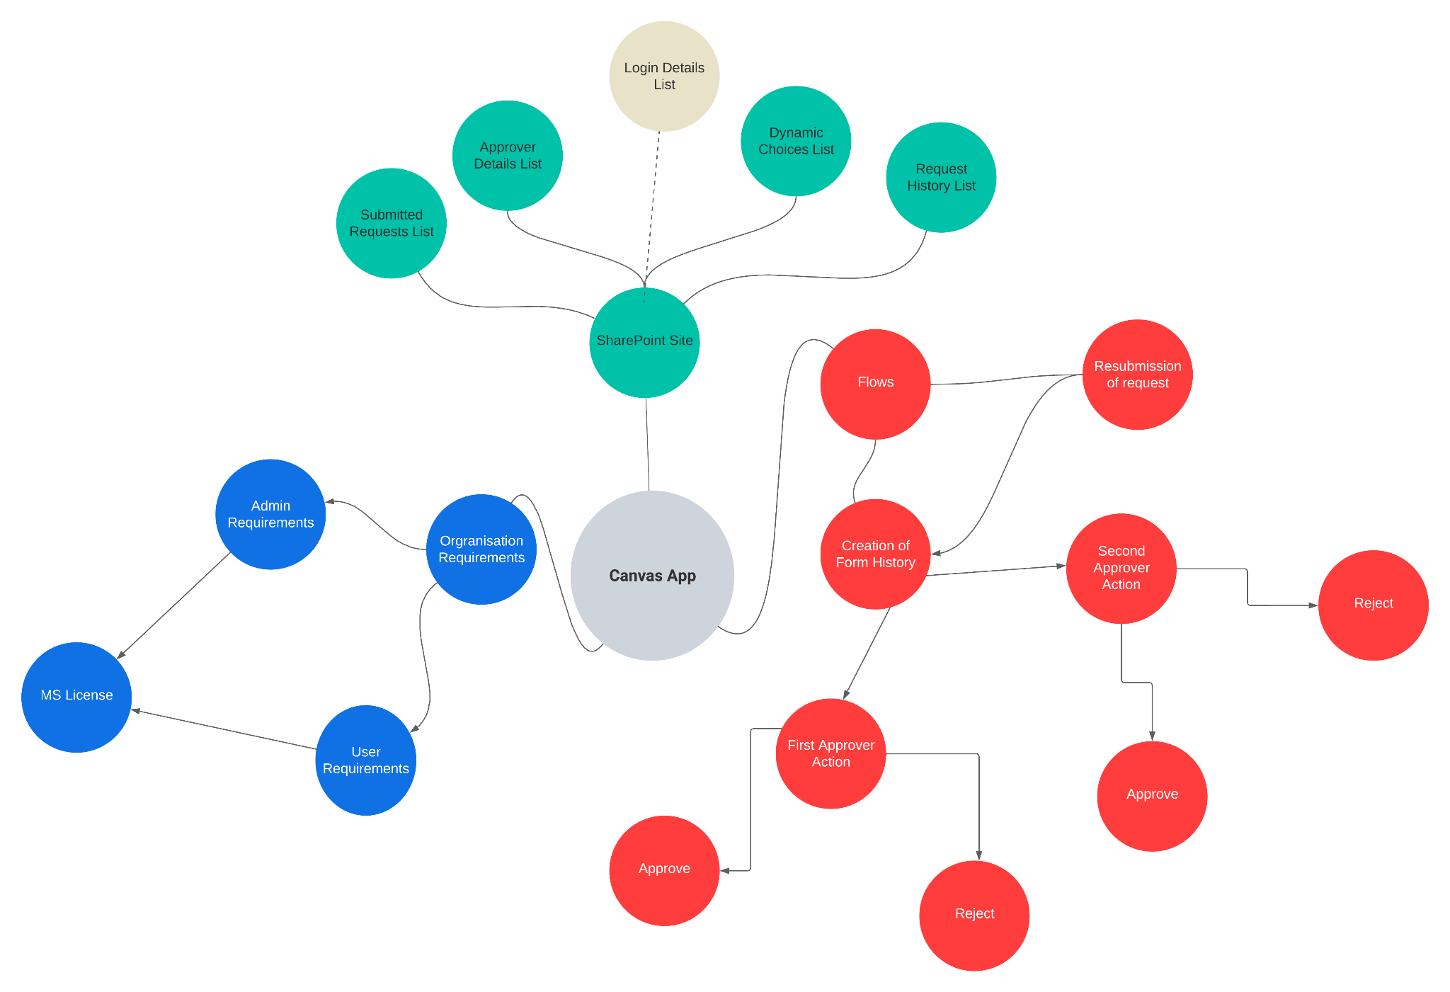

Slide 5
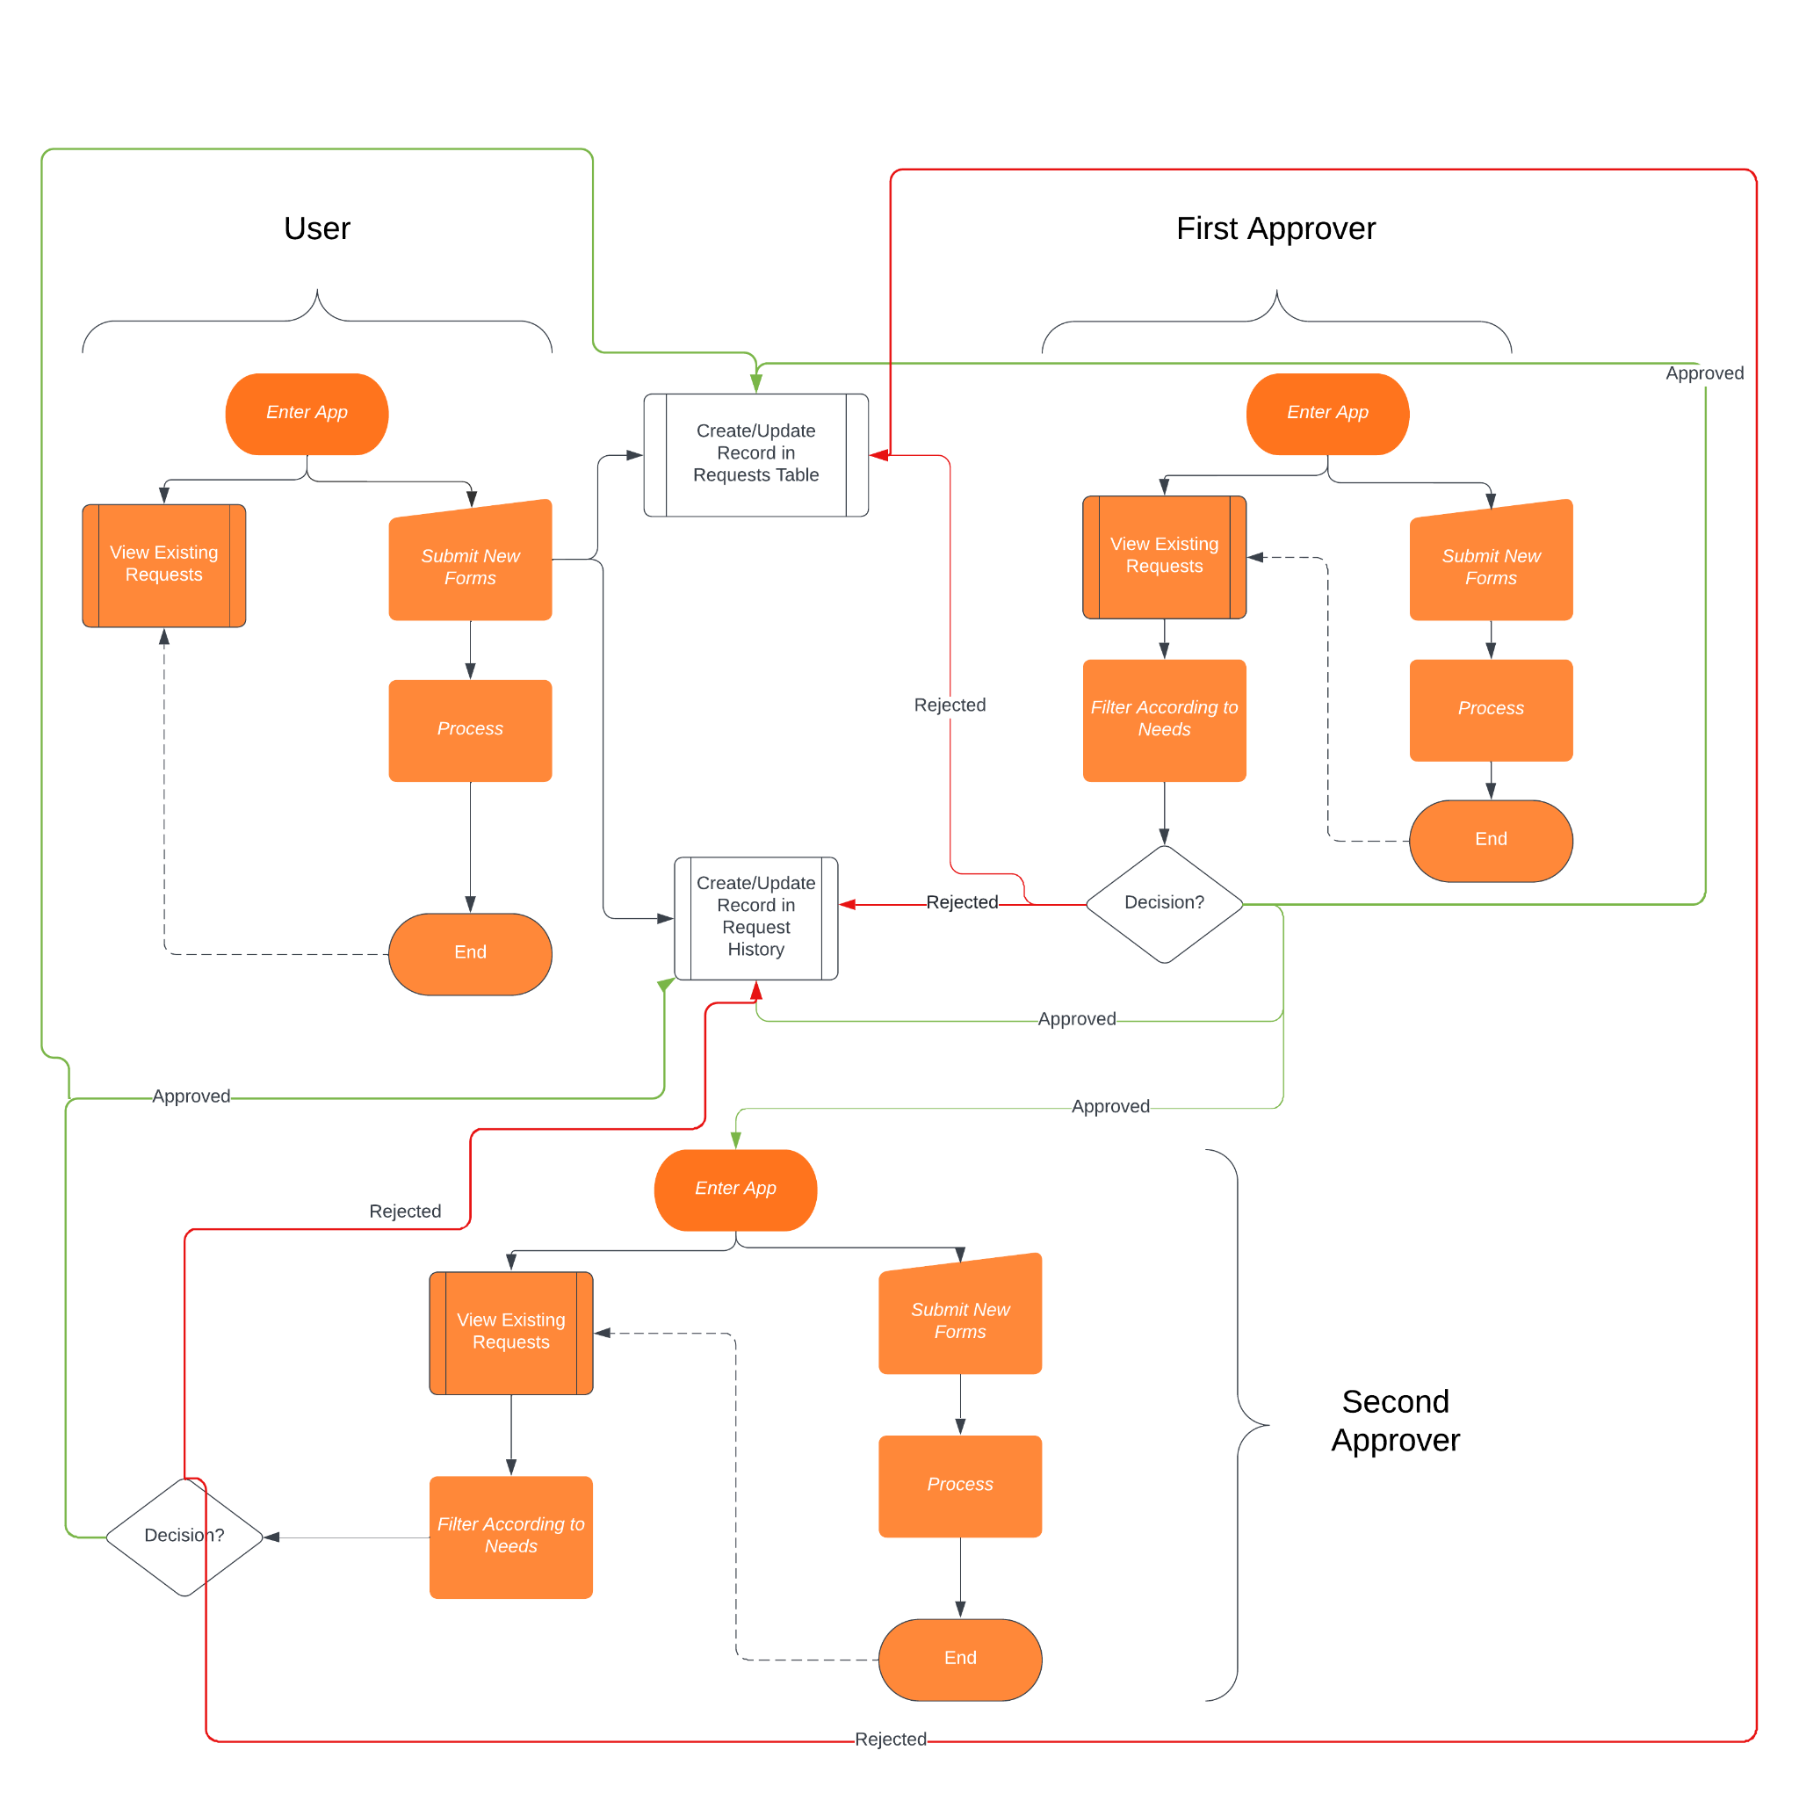

Slide 6
Issues Faced
Solutions
Mapping Items(fields) of selected requests to forms for viewing | Changing Items Property of the Form to Gallery’s Selected ID value.
PowerApps Connector in Power Automate requires (user)ID Input | Provide Last Submit Form ID
Editable Comment field for Approvers | Use a variable to handle all other fields except Comments Field
Change History in single List | Use Two Separate Columns to track IDs of the created history changes.
Provide button to filter requests according to their status. | Created a Table of button in a gallery which acts as a mediator for filtering the requests

Slide 7
Features
Drawbacks
Handles hierarchical behaviour of Approvers
Allows action of approvers only if it pertains to them
Filters requests according to needs of users/approvers
Handles same form to submit and view existing requests(user)
Gallery control to view all requests (user/approver)
Login/Registration Screen(optional)
Data Transparency with regards to SharePoint
Power Automate Flows have high delay

Slide 8

Thank you

